Slide 1
Melissa Seeley animal control officer since 2017 Nationally certified

Slide 2
What does animal control do?
Animal Control Officers not only protect the well-being and health of animals in the communities, but we also safeguard the citizens of Weston. We are sworn-in officers and are able to write infractions, misdemeanor summons, and search and seizure warrants if needed. We complete yearly continuing education and re-certification while staying up to date on new findings in our field.
We’re here to serve the citizens and protect the animals domestic as well as wildlife. If you have any questions feel free to reach out to dispatch at (203) 222-2600. They will patch you through to us.

Slide 3
Let’s talk about wildlife

Slide 4
Weston is largely made up of wildlife preserves Trout Brook Katherine Ordway and devils den to name a few
A nature preserve is a protected area of importance for flora, fauna, funga, or features of geological or other special interest, which is reserved and managed for purposes of conservation and to provide special opportunities for study or research.
*Wikipedia

Slide 5
In this area of Connecticut, you will see wildlife out and about. Just seeing an animal is not something to be worried about.

Slide 6
Let’s meet some of our wild neighbors.
“Look deep into nature, and then you will understand everything better.”
*Albert Einstein

Slide 7
The Coyote-first documented in the 1950’s they are now common across Connecticut and live in a variety of habitats

Slide 8
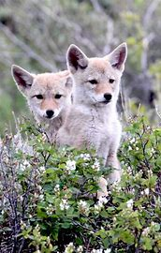
Myth: coyotes must be hunted to control their numbers
Truth: Coyote populations self-regulate on available food sources and prey availability. Scientific studies have shown that when hunted the pack’s social structure is disrupted especially if the breeding pair is killed. This means more food availability for the remaining pack members. With more food and nutrition females may now breed at a younger age and have larger and healthier litters. The lesson learned is that the harder the coyotes are hunted the faster their population grows.

Slide 9
“What should I do if I see a coyote in my yard or on my property?”

Slide 10
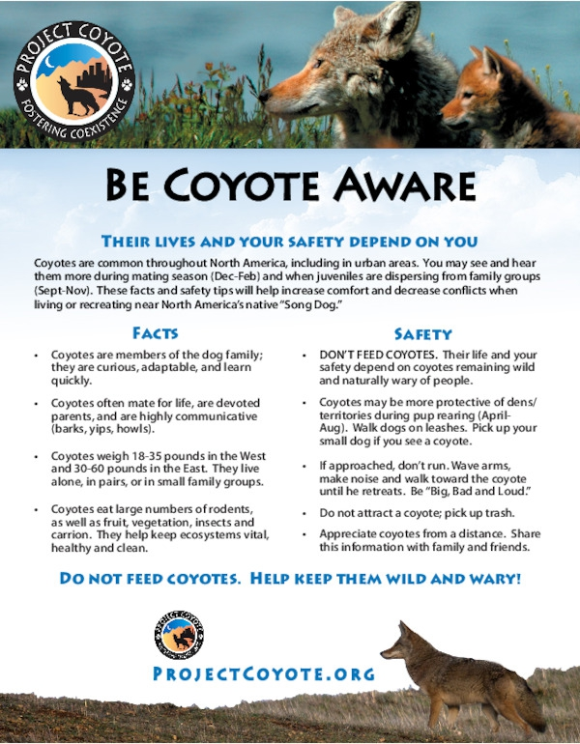
*Do NOT leave pets outside unattended
*Do NOT leave pet food outside
*Keep garbage in a secure container and only put it outside on the morning of pickup
*Do NOT put meat scraps in compost heaps
*Hazing is the most effective way to deter coyotes: Be big and scary-raise your arms over your head yell, blow a whistle, bang metal pots together, or aim a hose at the coyote. Keep an aluminum can with pennies and pebbles inside it and shake it hard if you see them in the area.

Slide 11
Black bear
Bear rarely turn down a snack. They are constantly looking for food and will spend up to 8 hours a day foraging. When they are drawn to a home or yard it is because they are looking for food. If they find a food source they will be back.

Slide 12
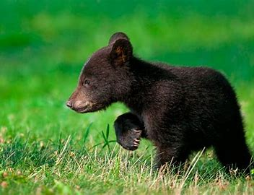
Myth: bear that wander into towns are dangerous
Bear often walk through neighborhoods in their search for food; this is natural behavior. If people have stored their food and garbage properly, a bear will likely keep on going. However, bears that get unnatural food in neighborhoods may eventually lose their fear of people.

Slide 13
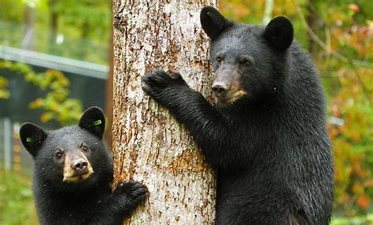
“What should I do if I see a bear on my property?”

Slide 15
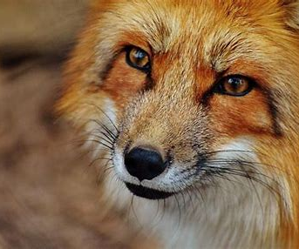
Red fox
Fox are important predators of prolific species like mice, rats, and rabbits. Red fox may dig their own burrows but usually improve an abandoned woodchuck burrow. The red fox will commonly den underneath sheds or decks.

Slide 16
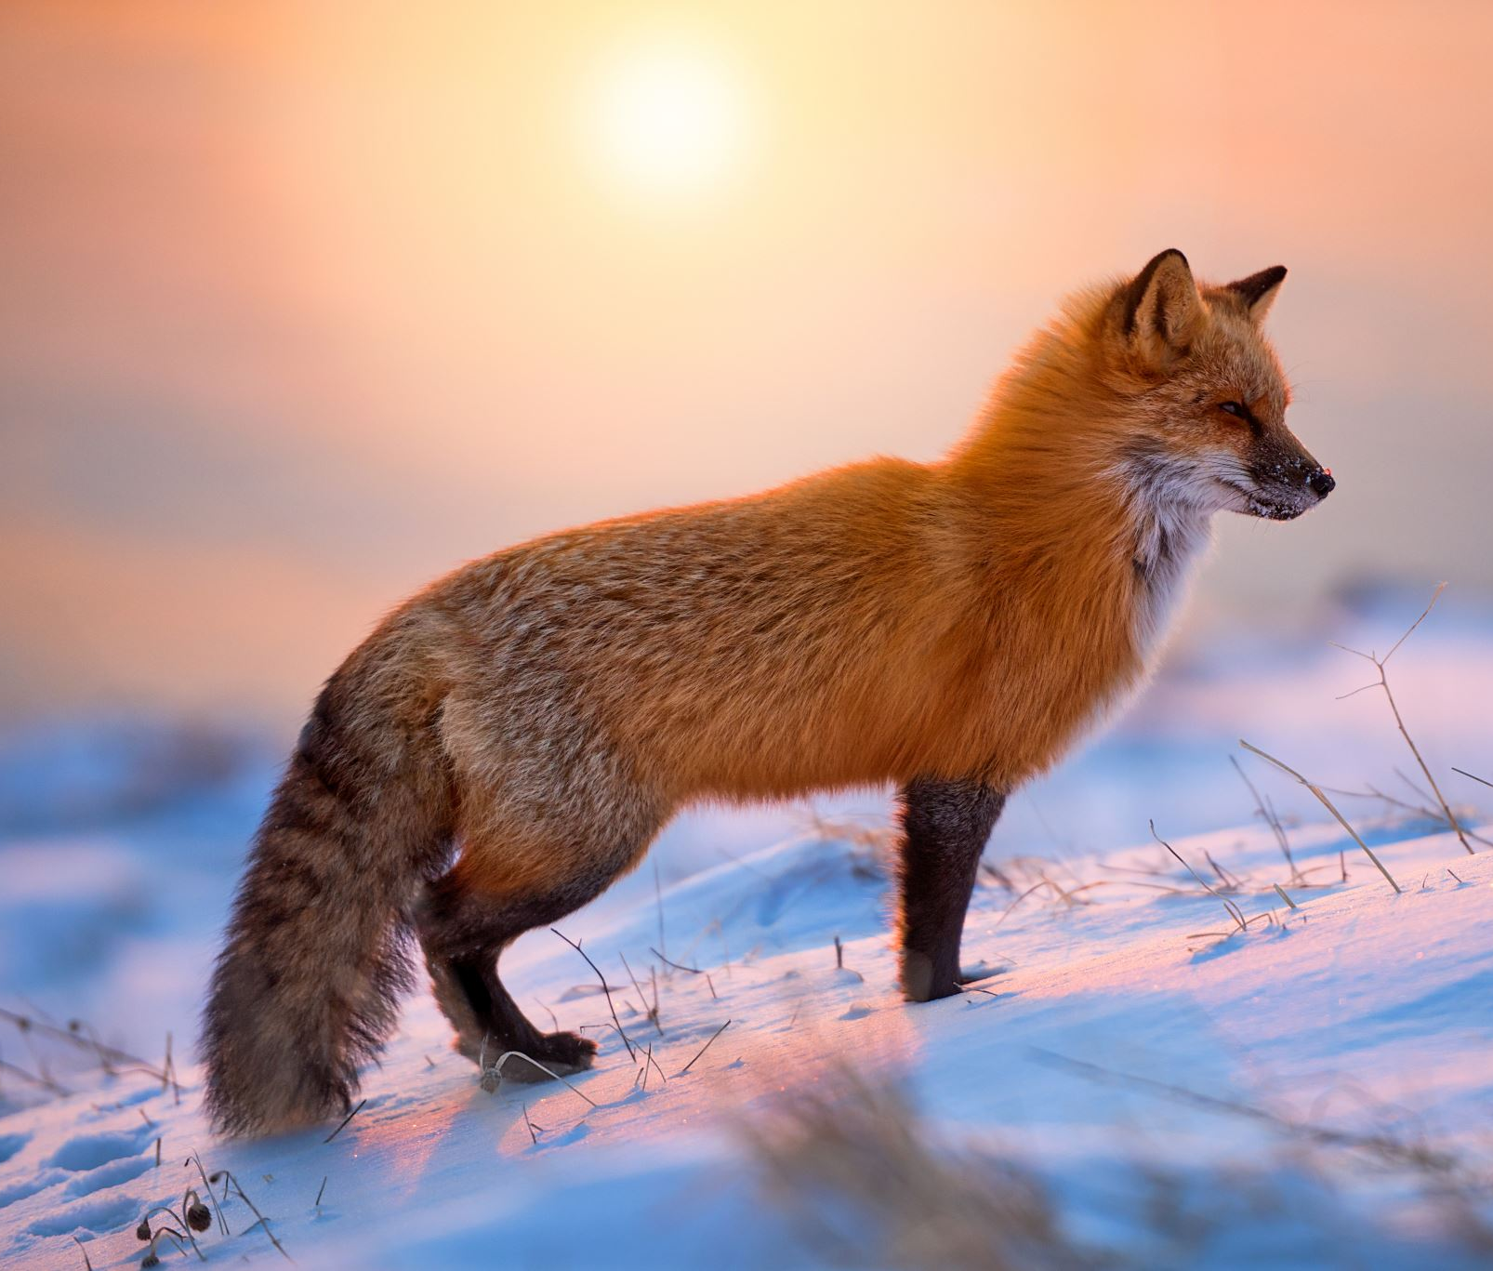
Myth: the fox will attack children
Unless sick, a fox will not attack a human or child. Even when they are captured their natural tendency is to flee rather than to fight.

Slide 17
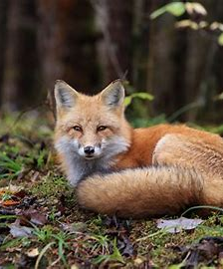
“What should I do if there is a fox on my property?”

Slide 18
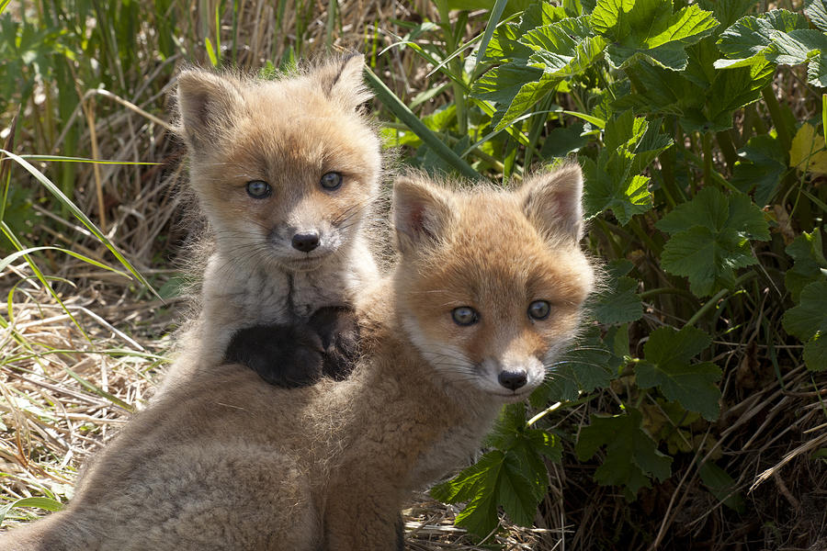
Fox will often pick dens near human dwellings when they are about to have their kits. Their reasoning seems to be that most wildlife do not want to be near humans therefore it is safer to start their family closer than other wildlife would feel comfortable. They will not stay long and once the kits are more able-bodied they will move back into the forest. In the meantime, the fox will take care of any rodents that may be in the area. While you can haze them the same as the other animals that we have talked about in prior slides it is usually best to just let them stay for a bit and once they leave have a professional fix the den and make it so that the fox can not return to it the next year.

Slide 19
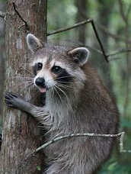
Raccoon
Though crepuscular (active at dawn and dusk) they will adjust their feeding schedules, especially in the spring when rearing their young.

Slide 20
Myth: If you see a raccoon out during the day, it has rabies
There are many possible reasons that you may see one during the day, and spotting one during the day is not a sign of rabies. Some of the reasons include foraging for food or to even bask in the sun.

Slide 21
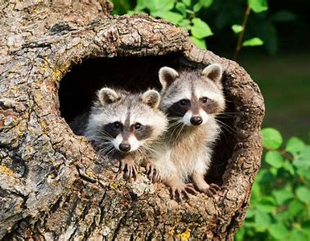
What should I do if I see a raccoon on my property

Slide 22
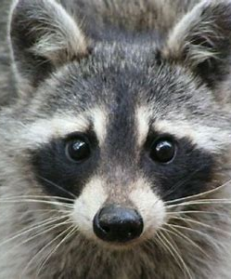
It’s all about prevention
* Do NOT feed or touch raccoons
* Secure garbage cans- Keep garbage in tightly closed containers and stored in a garage or shed.
* Feed pets indoors- pet food left out inadvertently feeds a variety of wildlife species
* Eliminate any potential denning areas- A nuisance wildlife company can help if you are unsure of how to do this
* Sometimes female raccoons can be encouraged to move her young by using repellants, such as ammonia or moth balls, combined with a light and noise from a portable radio placed near the den.

Slide 23
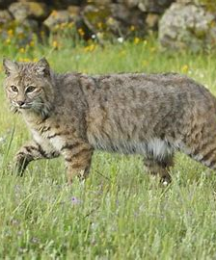
bobcat
Bobcats will have multiple den sites, usually with a main den and other auxiliary dens around their range.

Slide 24
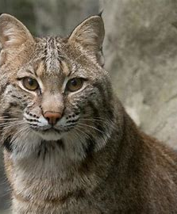
Myth: bobcats want to eat your pets
Fact: Bobcats just like other wildlife just want to eat. For large dogs there isn’t much worry but as always keep your eye on smaller dogs when outside and keep your cats indoors.

Slide 25
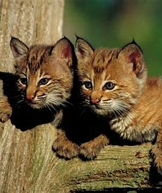
What should I do if I have a bobcat on my property?
Hazing the cat when you see it is the best course of action for these wild felines. Yelling or clapping loudly is often enough to get them to move on.
You can report the sighting on the CT DEEP website. Go to the website and type in bobcat reporting into the search bar
Bobcat attacks on people are extremely rare and rarely cause conflicts with human activities.

Slide 26
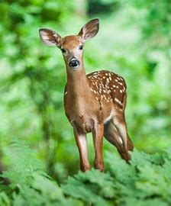
White tailed deer
White-tailed deer are excellent swimmers and are not afraid to pass through waterfronts for food or a new habitat.

Slide 27
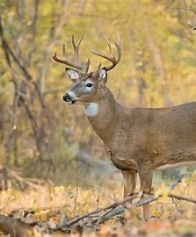
Myth-If you see a fawn alone it has been orphaned
Fact- In the first weeks of life it’s a natural survival strategy for the doe to keep her distance except for short bouts of nursing. It is rare for a doe to abandon a fawn- unless she has been killed by a vehicle or predator

Slide 28
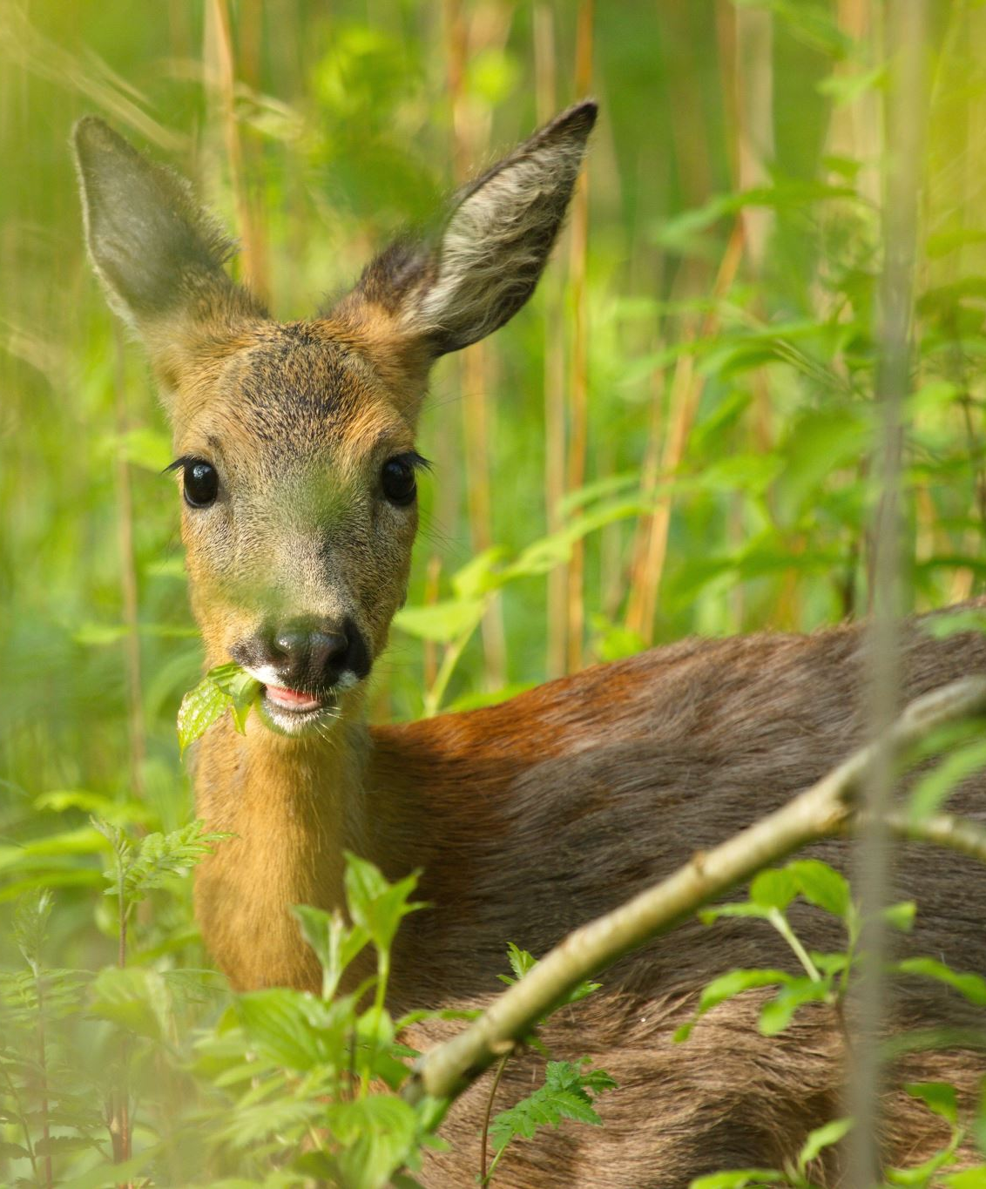
The deer are in my yard and ruining my plants!! What can I do?

Slide 29
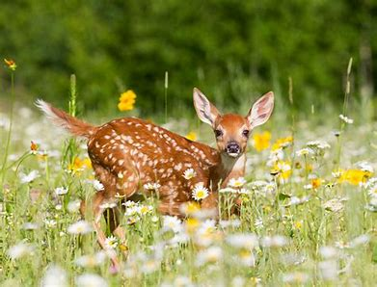
How to make your yard less tempting to deer
*Eliminate deer attractants. If you have a garden harvest produce as soon as it is ready.
*Maintain your landscape. You do not want them bedding down for the night.
*Let your dog spend time outside. A barking dog is a big deterrent for deer

Slide 30
The animals discussed in these slides are just a few we have received calls and concerns about. When it comes to large wildlife we ask that residents refer to the CT DEEP website or contact DEEP by using the contact us link on their page. Quite often there is a quick solution that is on the website. Animal Control officers are unable to assist with bobcats, deer, coyotes or bear if they are mature. We do not have the safety equipment, transportation, or the facility to hold these animals. We can however assist and help with orphaned or injured juvenile wildlife. CT state laws limit rehabilitators to only being able to work with young wildlife and not adult wildlife.

