Slide 1
Commission and Committee Rationalization Project
Discussion with the Board of Selectman
June 15, 2023

Slide 2
Scope of Work
Review appointed commissions and committees to ensure that the charge, or the work they are commissioned to do is relevant
Identify synergies/overlap in existing committees
Prepare materials for BOS for discussion and potential rationalization
Prepare a volunteer handbook

Slide 3
Commission vs Committee What’s the Difference?
A committee is a group of people appointed by the Board of Selectmen who meet, deliberate and produce a recommendation based specific question or specific advisory need
A commission is statutorily derived from the Town charter or state, empowered with decision making authority on specific functions on an ongoing basis

Slide 4
Charter

Slide 5
Charter

Slide 6
Ordinance

Slide 7
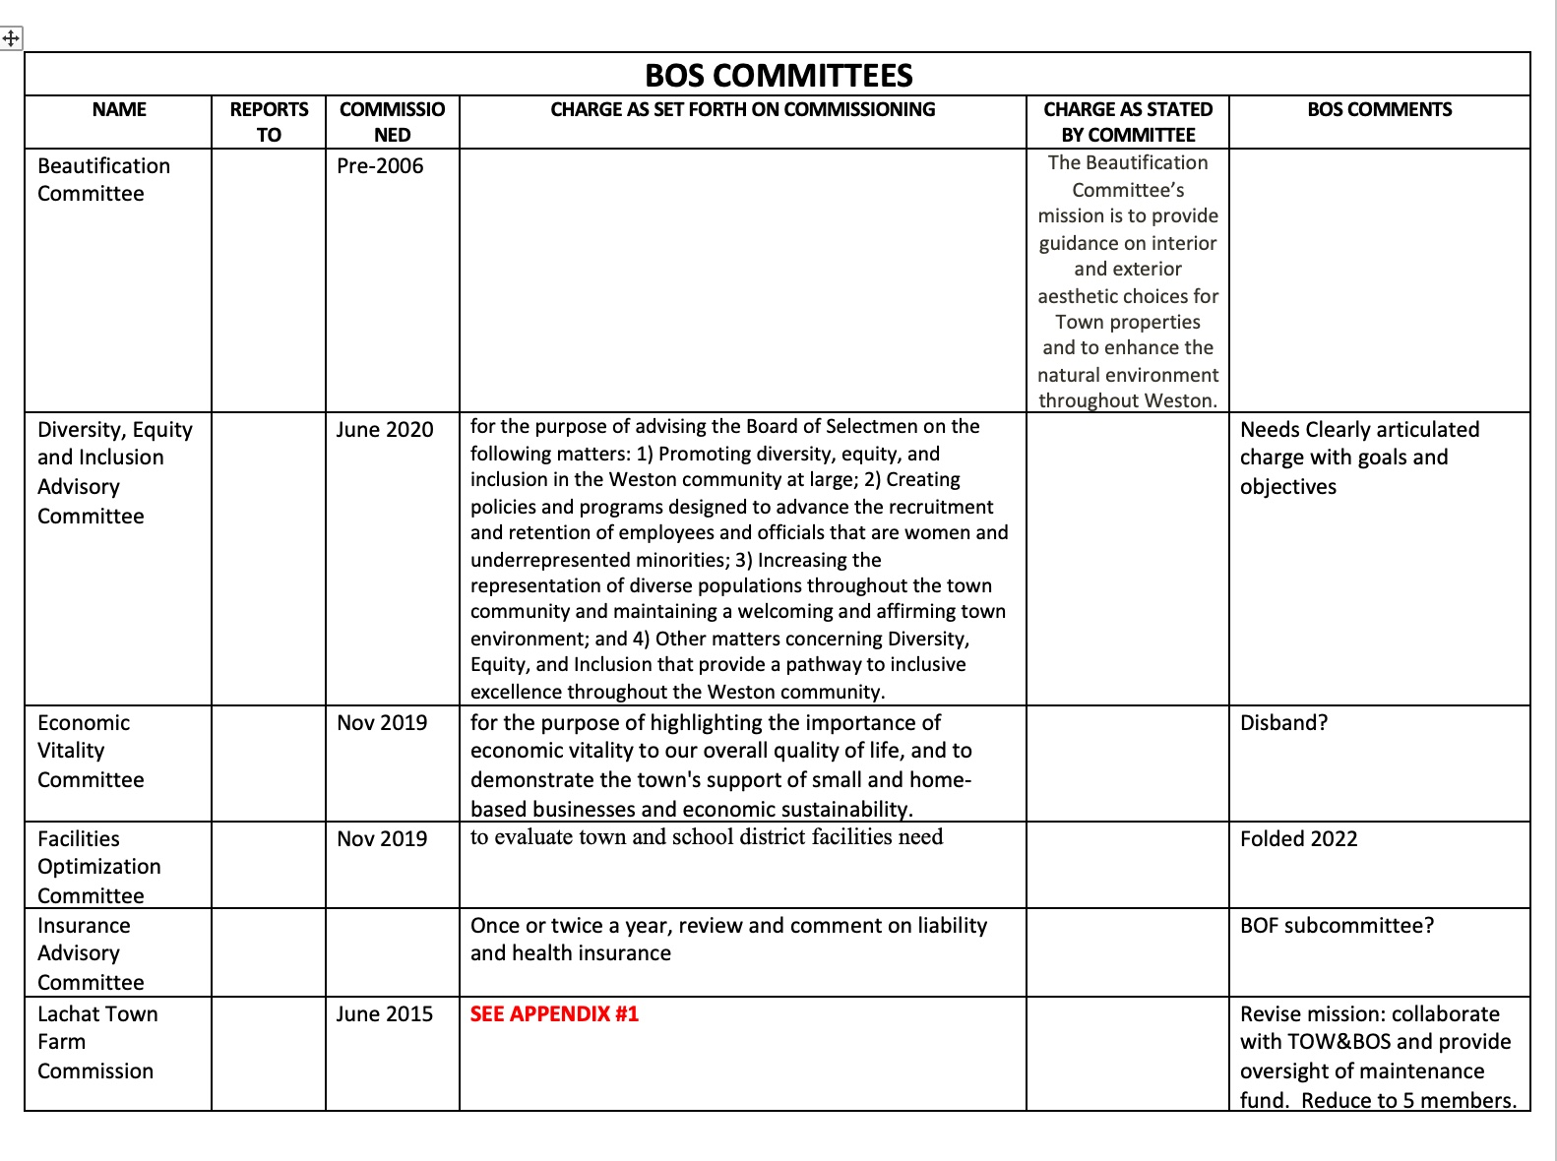
Board of Selectmen

Slide 8
Board of Selectmen

Slide 9
For consideration and agreement
The BOS should
determine if the existing committees have executed against their charge
if there is still work to be done, review the "charge" to ensure it is relevant
Committees should
be granted an annual/biennial review with the BOS
have the opportunity and means to leverage other committees’ work
assign a selectperson advisor/liaison
advocate for FOIA compliance
create and codify a process for publicizing vacancies
set 3-5 goals that reflect the work to be done to execute against their charge

Slide 10
The TOW needs a Process for Committees that both Values the talents of the community and serves the needs of the Town
Commissioning
Charge should be clear
Accountabilities
Allow for public participation/public comment
Absolute compliance with FOIA (TA report twice a year) and business norms
Charge
BOS annual renewal of charge (is it still relevant? Should we be sunsetting?
Vacancies
Skill set should match the needs of the committee
Interested parties shall have attended a minimum of 2 meetings to be familiar with work and the committee
If there is more to be done, the BOS can amend the charge
Recruitment
Demonstrated expertise in the area of expertise
Broad reach to community (to include unaffiliated voters)
The committee (C&VC) should vet and nominate candidates (for approval by the BOS??)
Populating a New Committee
The Chair shall vet candidates with expertise needed to populate the committee
The BOS should interview candidates with demonstrated expertise and experience to co-chair the committee
The co-chair will recommend to the BOS ideal size of committee (3-7) and time commitment
The Chair recommends candidates to the BOS
Adhering to the charge
We need to spend less time interviewing candidates and more time reviewing their work

